Slide 1
Mch4921 FALL 2023 PROJECT ACTIVE BALL BALANCING TABLE
Group Members:
Kaan Özcivan 2002098
Kutay Marangoz 2000703
Yaren Yasmin Engin 2003236
Remzi Dağhan Kara 1901852
Instructor:
Associate Prof. Mehmet Berke Gür

Slide 2
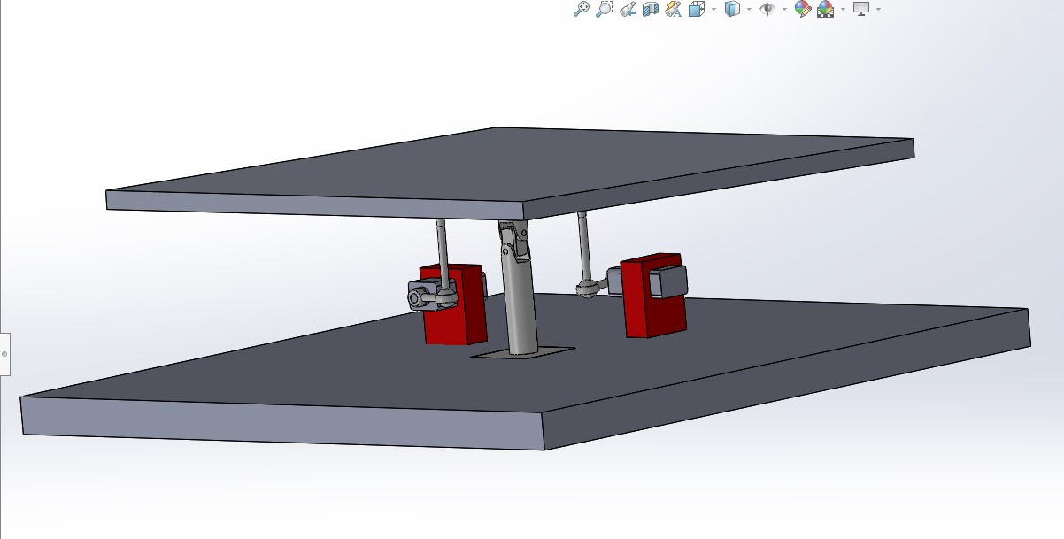
INTRODUCTION
Ball Balancing Table System
Technical Drawings
Controller Design
Simulation
Theoretical calculations
Aim of the Project
Balance the thrown ball under 10 seconds

Slide 3
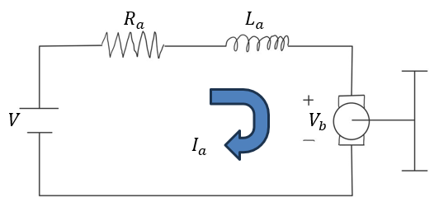
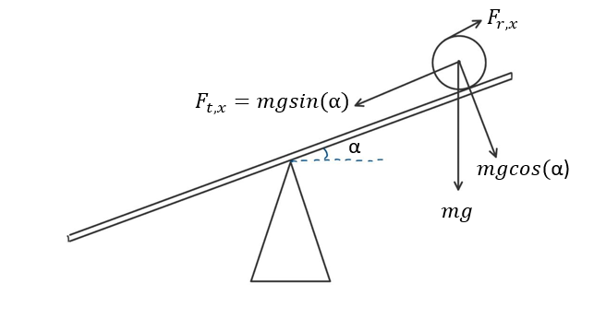
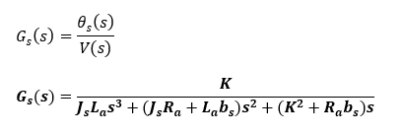
Mathematıcal modelıng of the system
Figure 1. Electrical Circuit of the Servo Motor
Figure 2. Free Body Diagram of 2D system
Figure 3. Transfer function of Servo Motor

Slide 4
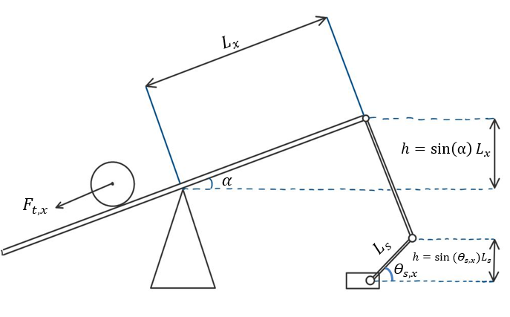
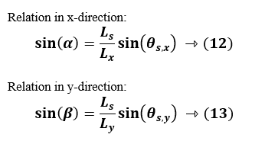
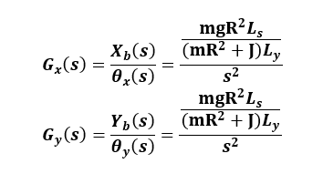

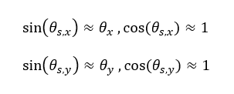

Mathematıcal modelıng of the system
Fig. 5 Relation in x and y directions
Figure 4. Ball Balancing Table System Relations
Figure 9. Transfer function of the system
Fig. 6 Linearization
Fig. 7-8 Laplace transform in x and y angles

Slide 5
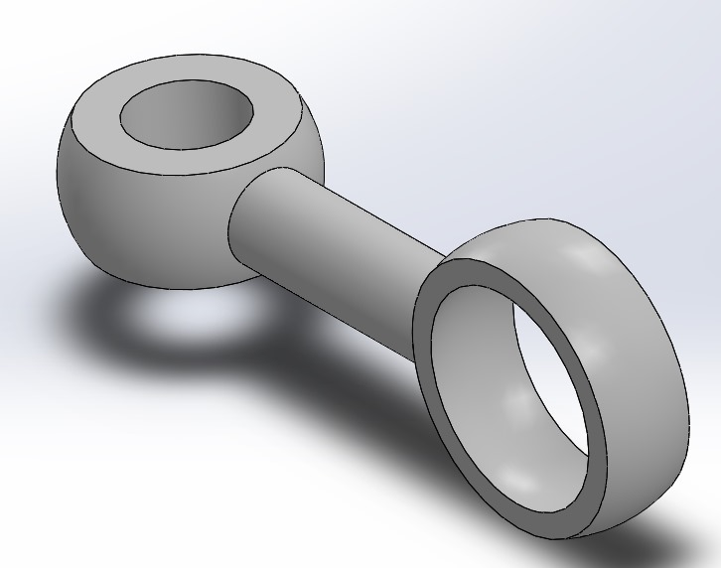
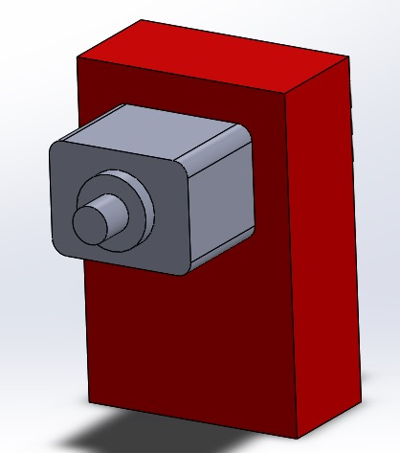
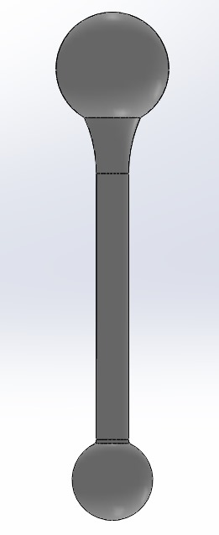
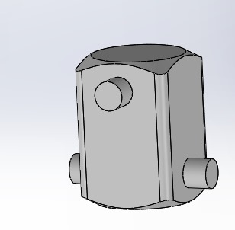
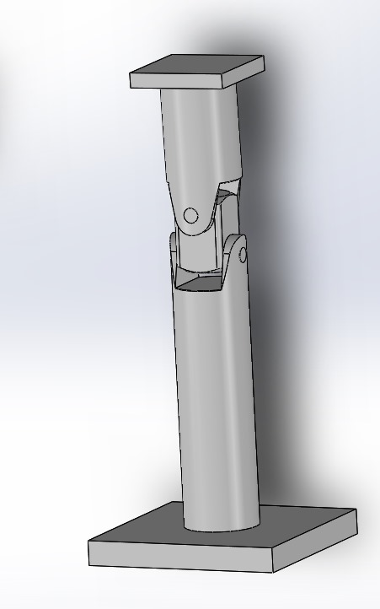
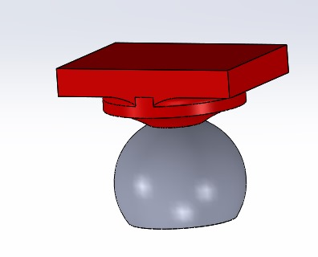
CAD DESIGN
Figure 12. Servo motor link
Figure 14. Servo motor
Figure 10. Plate Arm
Figure 13. Universal Joint Middle Section
Figure 11. Universal Joint
Figure 16. Assembly of the Ball Balancing Table
Figure 15. Connection port for the Plate Arm

Slide 6
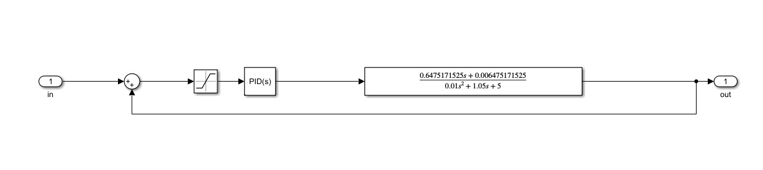
PID CONTROLLER DESIGN
Figure 17. Block Diagram of the Servo Motor Transfer Function on Simulink

Slide 7
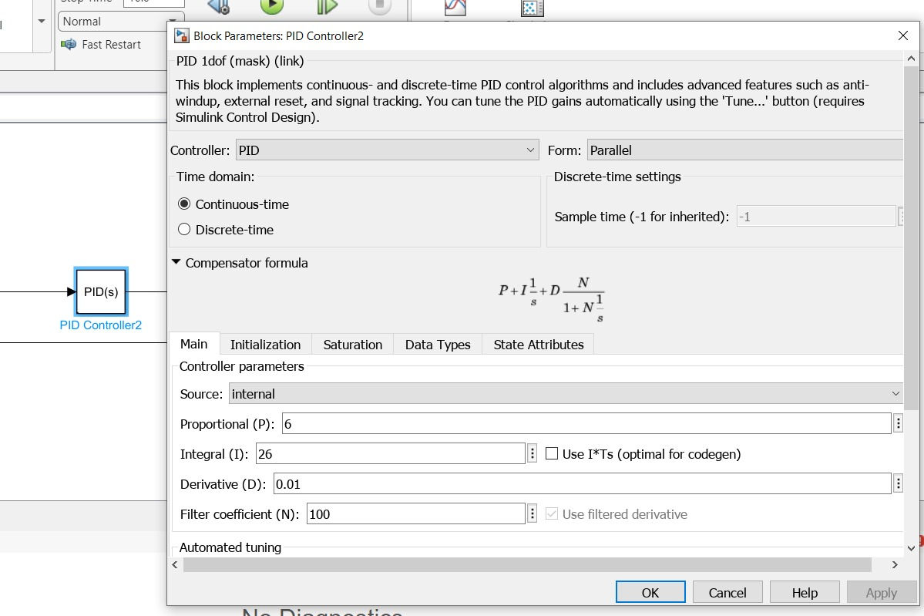
PID CONTROLLER DESIGN
Figure 18. Proportional, Integral and Derivative Gain values of the PID Controller

Slide 8
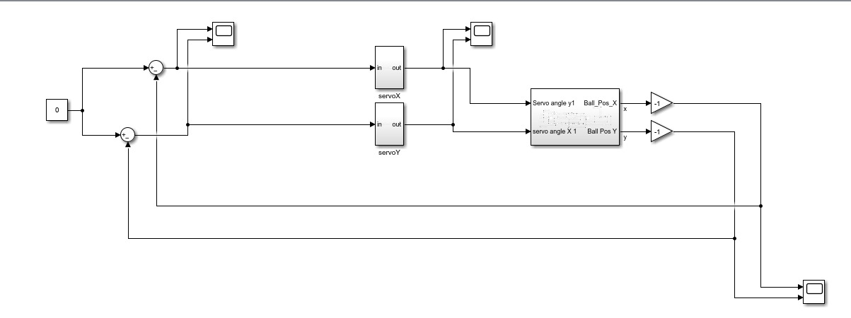
PID CONTROLLER DESIGN
Figure 19. Block Diagram of the Negative Feedback System on Simulink

Slide 9
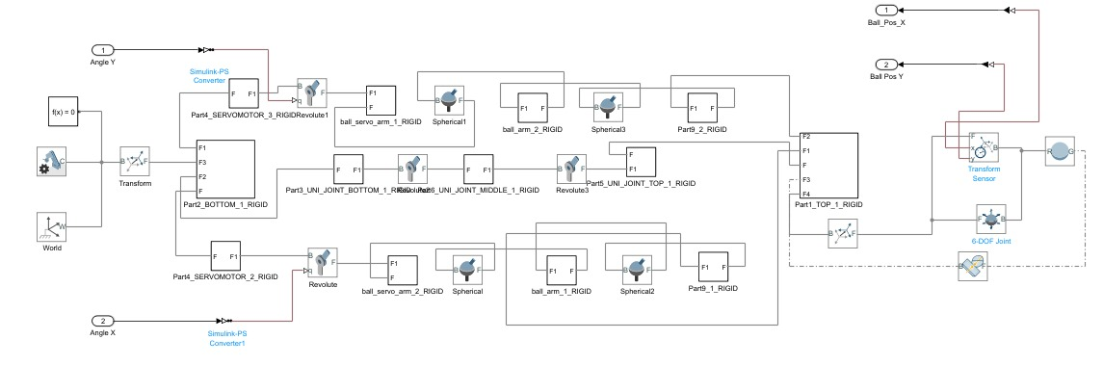
Figure 20. Block Diagram of the Subsystem on Simulink

Slide 10
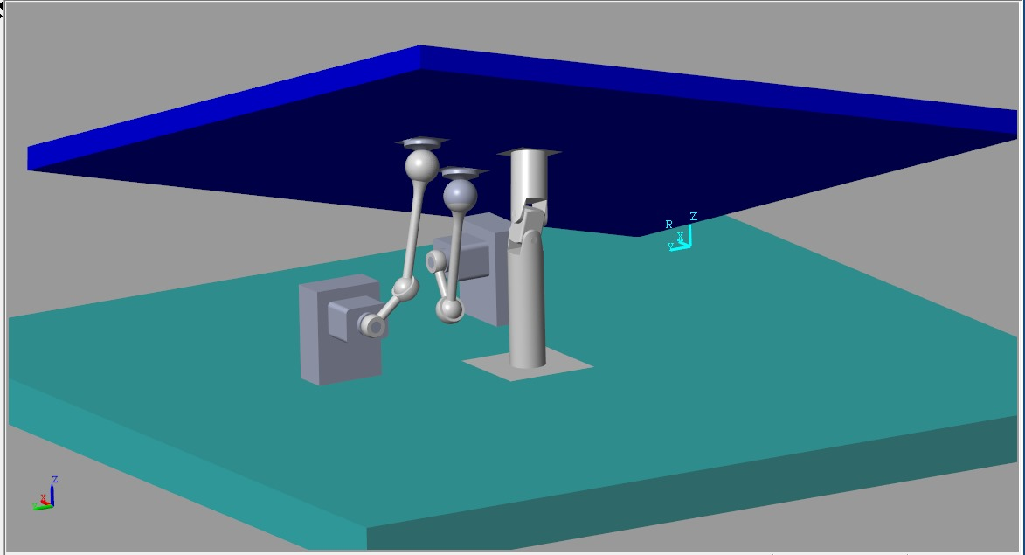
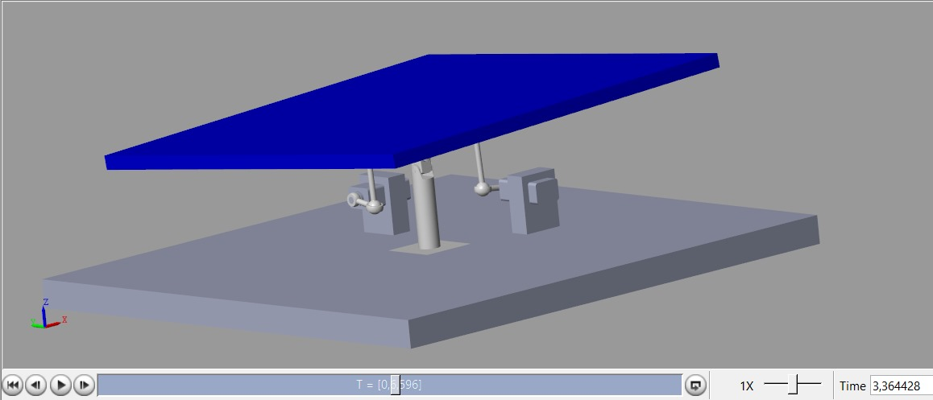
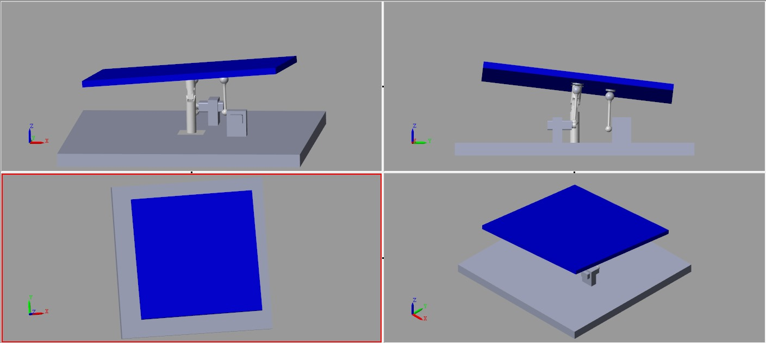
SIMULATION
Figure 22.
Figure 21.
Figures 21, 22, 23. Images taken during the simulation
Figure 23.

Slide 11
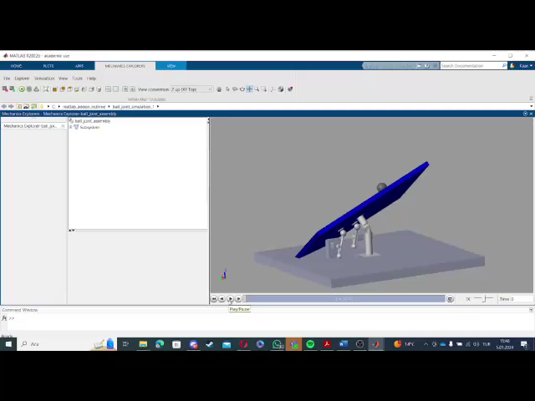
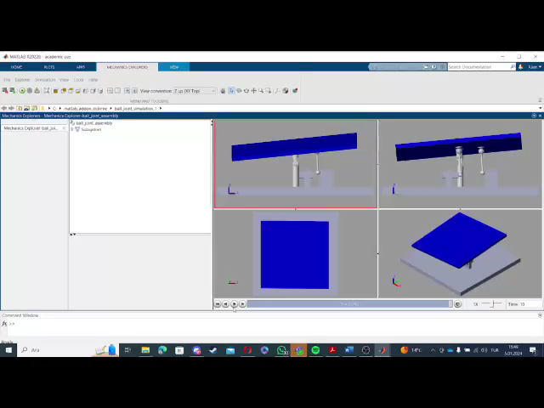
SIMUlATION

Slide 12
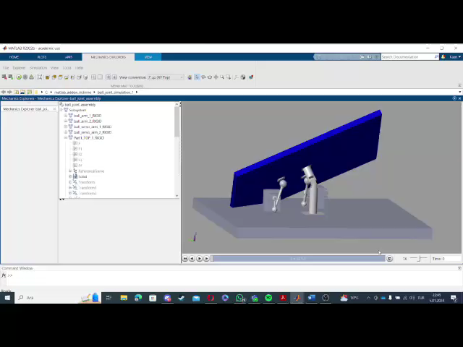
SIMULATION

Slide 13


RESULTS
Ball Balancing Table System
Theoretical calculations
Technical Drawings
Controller Design
Simulation
Problem Solving;
Do research and find optimal solution
Problem solving;
Apply experimentation with different parts
Problem solving;
Apply trial and error
Problem solving;
Apply trial and error
Successful Successful Partially Succesful Partially Succesful

